Slide 1

8th Grade Math: Pre-Algebra
Unit 3, Lesson 7 Dividing Numbers Expressed in Scientific Notation Volume 1, pg. 111

Slide 2


Benchmarks
MA.8.NSO.1.5
Add, subtract, multiply, and divide numbers expressed in scientific notation with procedural fluency.
MA.8.NSO.1.6
Solve real-world problems involving operations with numbers expressed in scientific notation.
volume 1, pg. 111

Slide 3
Integrated Mathematical Thinking and Reasoning Standards
MA.K12.MTR.1.1 Actively participate in effortful learning both individually and collectively.
MA.K12.MTR.3.1 Complete tasks with mathematical fluency.
MA.K12.MTR.4.1 Engage in discussions that reflect on the mathematical thinking of self and others.
MA.K12.MTR.5.1 Use patterns and structure to help understand and connect mathematical concepts.
MA.K12.MTR.6.1 Assess the reasonableness of solutions.
MA.K12.MTR.7.1 Apply mathematics to real-world contexts.
volume 1, pg. 111

Slide 4

Learning Targets
I can divide numbers expressed in scientific notation.
I can solve real-world problems involving operations with numbers expressed in scientific notation.
volume 1, pg. 111

Slide 5

Warm-Up
volume 1, pg. 111

Slide 6




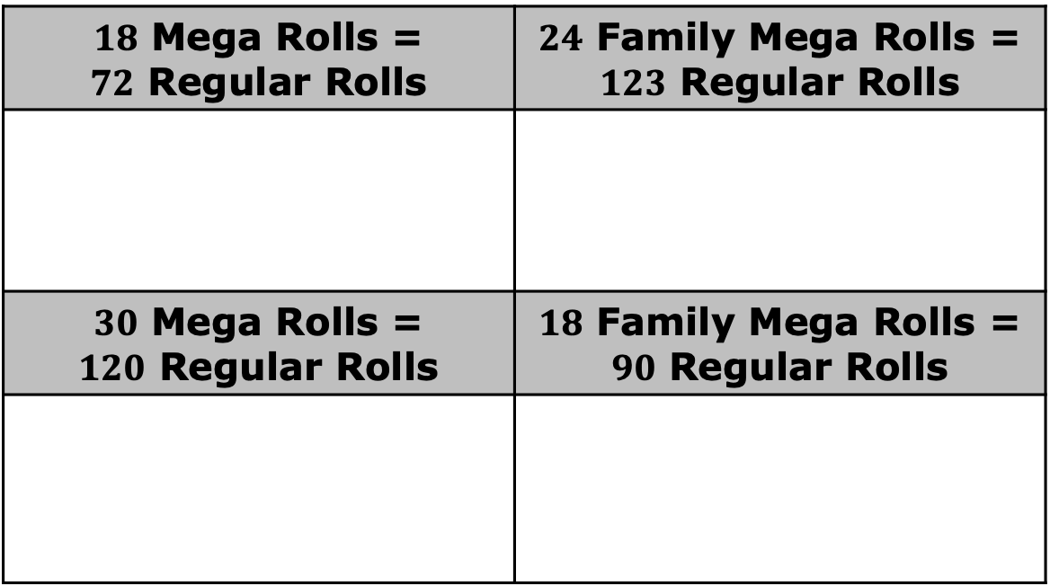
3.7.1 Warm-Up: Toilet Paper Math
The table shows information from four different toilet paper roll packages.
$18$ Mega Rolls = $72$ Regular Rolls | $24$ Family Mega Rolls = $123$ Regular Rolls
$30$ Mega Rolls = $120$ Regular Rolls | $18$ Family Mega Rolls = $90$ Regular Rolls
volume 1, pg. 111
Notes:
Video Link: https://algebranation.wistia.com/medias/fi4fidi5y8

Slide 7
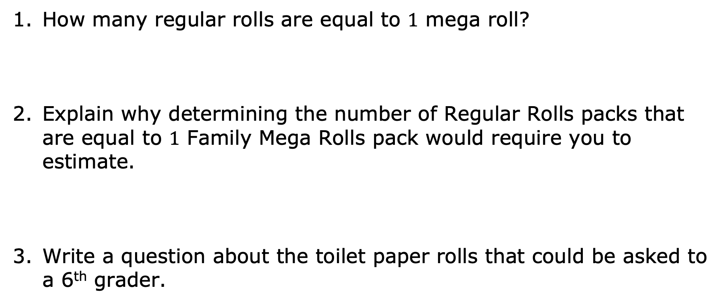
How many regular rolls are equal to $1$ mega roll?
Explain why determining the number of Regular Rolls packs that are equal to $1$ Family Mega Rolls pack would require you to estimate.
Write a question about the toilet paper rolls that could be asked to a 6th grader.
volume 1, pg. 111
Notes:
Video Link: https://algebranation.wistia.com/medias/fi4fidi5y8

Slide 8

Exploration
volume 1, pg. 112

Slide 9

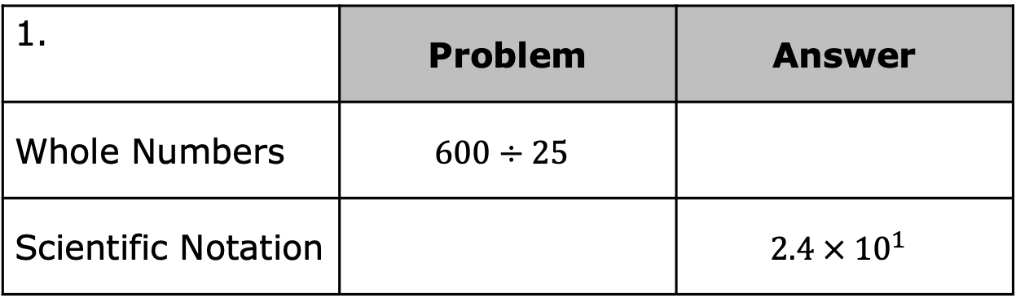
3.7.2 Exploration: Making a Conjecture for How to Divide Numbers Expressed in Scientific Notation
Work with your partner to complete the problem in each table. First, determine the answer to the division problem in the first row, using whole numbers. Then, convert the whole numbers to scientific notation in the second row.
 | Problem | Answer
Whole Numbers | $$600÷25$$
Scientific Notation |  | $$2.4 × {10}^{1}$$
volume 1, pg. 112

Slide 10
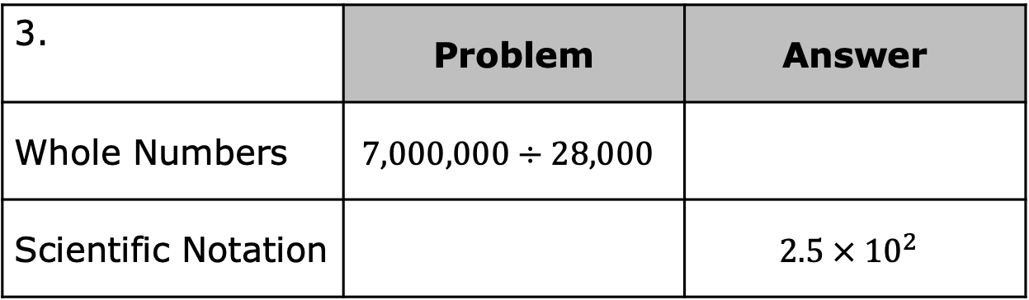

 | Problem | Answer
Whole Numbers | $$4500÷30$$
Scientific Notation |  | $$1.5 × {10}^{2}$$
 | Problem | Answer
Whole Numbers | $$7,000,000÷28,000$$
Scientific Notation |  | $$2.5 × {10}^{2}$$
volume 1, pg. 112

Slide 11
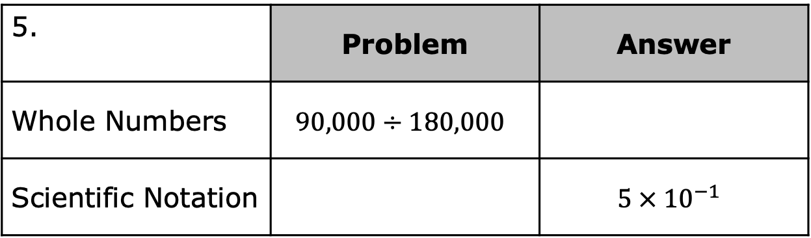

 | Problem | Answer
Whole Numbers | $$70,000÷28,000,000$$
Scientific Notation |  | $$2.5 × {10}^{−3}$$
 | Problem | Answer
Whole Numbers | $$90,000÷180,000$$
Scientific Notation |  | $$5 × {10}^{−1}$$
volume 1, pg. 112

Slide 12
What do you notice about the problems, using scientific notation and their corresponding answer?
Make a conjecture about how to divide numbers written in scientific notation.
volume 1, pg. 112

Slide 13
Ask two other pairs of partners for the conjectures they wrote. Listen to their conjectures and write a summary. You are the only person who should write in the first column of the table. Have the person initial next to your summary stating that your summary was accurate.
My Summary of Their Conjecture | Initials
Revisit your conjecture with your partner and resolve any differences if necessary.
volume 1, pg. 112

Slide 14

Guided Instruction
volume 1, pg. 113

Slide 15

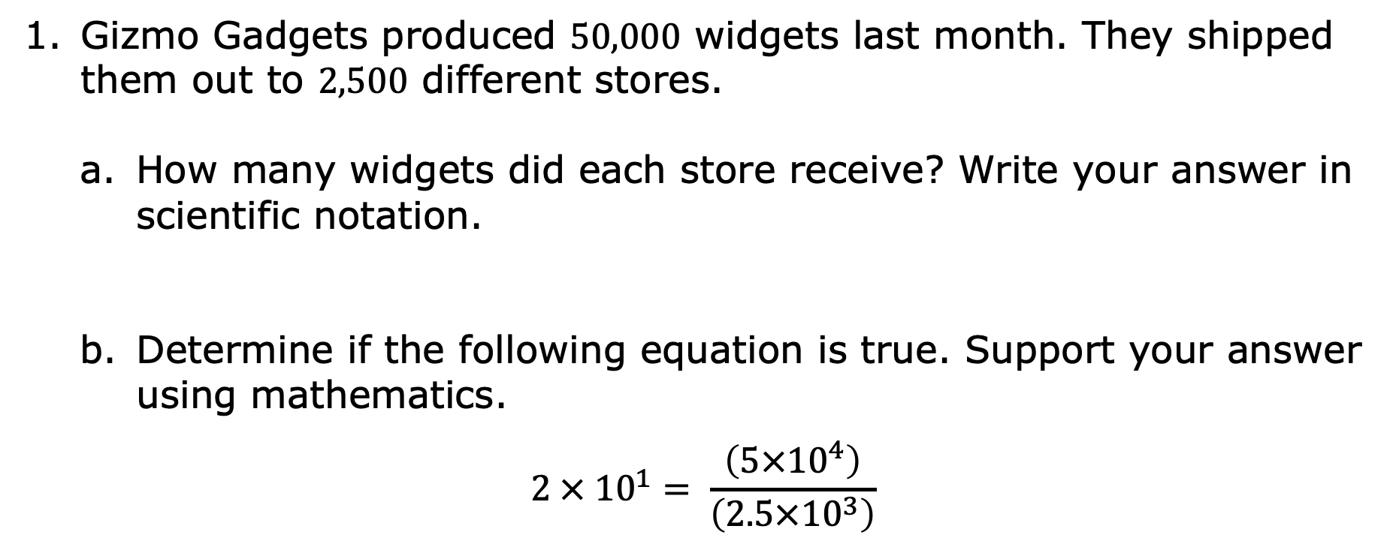
3.7.3 Guided Instruction: Dividing Numbers Written in Scientific Notation
Gizmo Gadgets produced $50,000$ widgets last month. They shipped them out to $2,500$ different stores.
How many widgets did each store receive? Write your answer in scientific notation.
Determine if the following equation is true. Support your answer using mathematics.
$$2 × {10}^{1}= \frac{\left(5×{10}^{4}\right)}{\left(2.5×{10}^{3}\right)}$$
volume 1, pg. 113

Slide 16
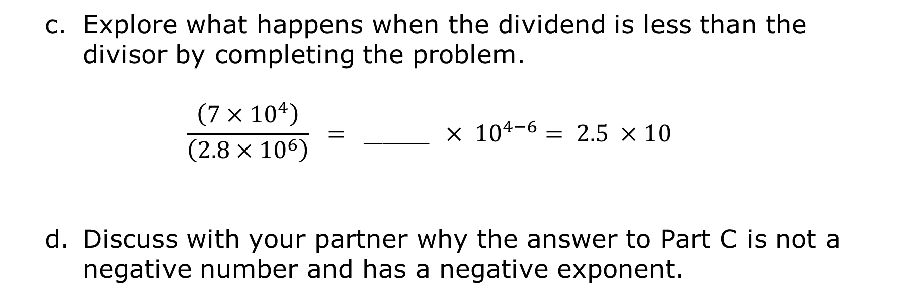
Explore what happens when the dividend is less than the divisor by completing the problem.
$$\frac{\left(7×{10}^{4}\right)}{\left(2.8×{10}^{6}\right)} = _______ × {10}^{4−6}= 2.5 ×{ 10}^{ }$$
Discuss with your partner why the answer to Part C is not a negative number and has a negative exponent.
volume 1, pg. 113

Slide 17
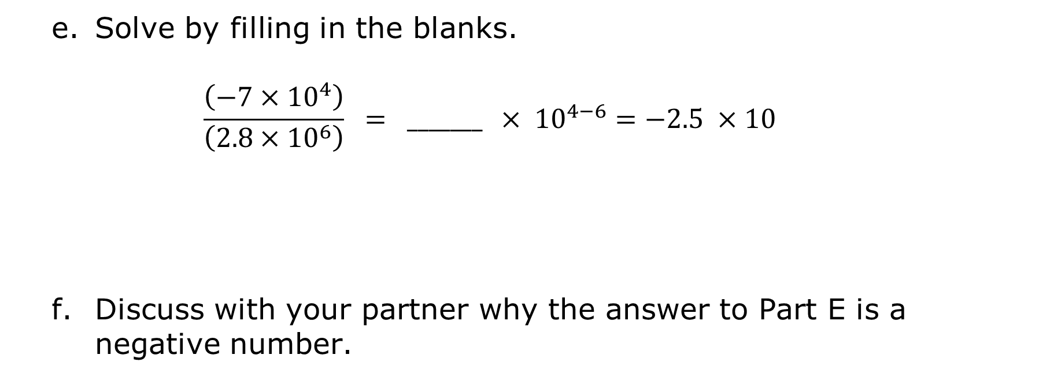
Solve by filling in the blanks.
$$\frac{\left(−7×{10}^{4}\right)}{\left(2.8×{10}^{6}\right)} = _______ × {10}^{4−6}=−2.5 ×{ 10}^{ }$$
Discuss with your partner why the answer to Part E is a negative number.
volume 1, pg. 113

Slide 18
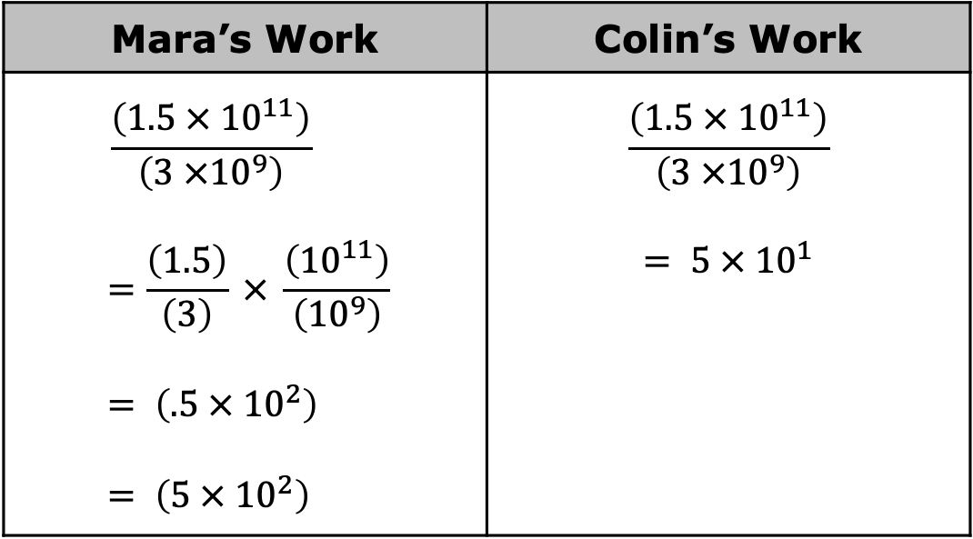
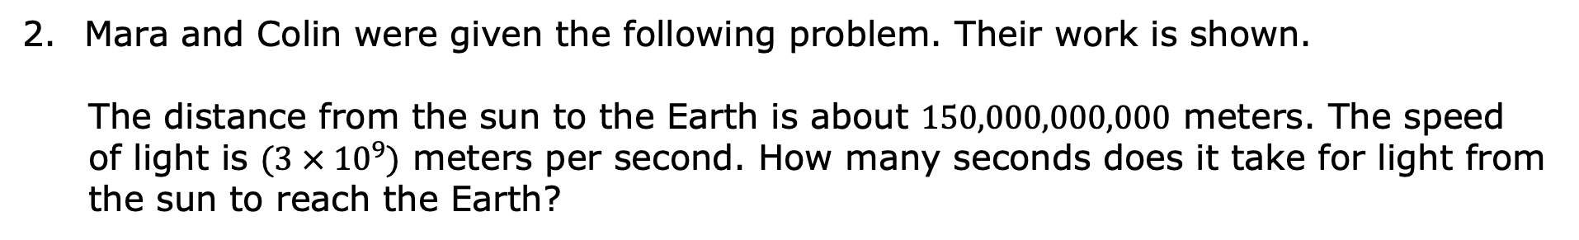
Mara and Colin were given the following problem. Their work is shown.
The distance from the sun to the Earth is about $150,000,000,000$ meters. The speed of light is $(3 × {10}^{9})$ meters per second. How many seconds does it take for light from the sun to reach the Earth?
Mara’s Work | Colin’s Work
$$\frac{\left(1.5 × {10}^{11}\right)}{\left(3 ×{10}^{9}\right)}$$ $$=\frac{\left(1.5\right)}{\left(3\right)} × \frac{\left({10}^{11}\right)}{\left({10}^{9}\right)}$$ $$= \left(.5 × {10}^{2}\right)$$ $$= \left(5 × {10}^{2}\right)$$ | $$\frac{\left(1.5 × {10}^{11}\right)}{\left(3 ×{10}^{9}\right)}$$ $$= 5 × {10}^{1}$$
volume 1, pg. 113

Slide 19
Place your initials by the student’s name who has the correct answer in the table.
Circle and correct the error made by the student with the incorrect answer.
Write a note to the person who is incorrect, explaining their mistake.
Means
I
Start
To
Acquire
Knowledge
Experience
Skills
volume 1, pg. 113

Slide 20

Guided Practice
volume 1, pg. 114

Slide 21


3.7.4 Guided Practice: Finding Quotients
Find the quotient for each.
$\frac{\left(5.5 × {10}^{2}\right)}{\left(2.75 × {10}^{4}\right)}$
$\frac{\left(7.2 × {10}^{26}\right)}{\left(8×{10}^{26}\right)}$
volume 1, pg. 114

Slide 22

$\frac{\left(2.16× {10}^{−1}\right)}{\left(2 × {10}^{−2}\right)}$
$\frac{\left(9.87×{10}^{−4}\right)}{\left(4.7 × {10}^{−2}\right)}$
volume 1, pg. 114

Slide 23

Wrap-Up
volume 1, pg. 114

Slide 24

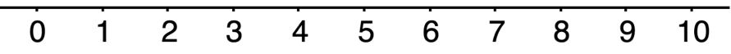
3.7.5 Wrap-Up: Reflection
Choose the emoji that reflects your understanding of dividing numbers expressed in scientific notation.
Complete the statement.
I chose this emoji because __________________________
_______________________________________________
_______________________________________________
______________________________________.
volume 1, pg. 114

